Slide 1
A Pain Management Perspective
C. Scott Anthony, D.O.
Pain Management of Tulsa

Slide 2
My Practice Observations
Definite change in referral patterns
The “perfect storm”
CDC guidelines have changed my practice
Frightened patients
My overriding goals
Improve function
Improve quality of life
Safe prescribing
Prevention of abuse and diversion

Slide 3
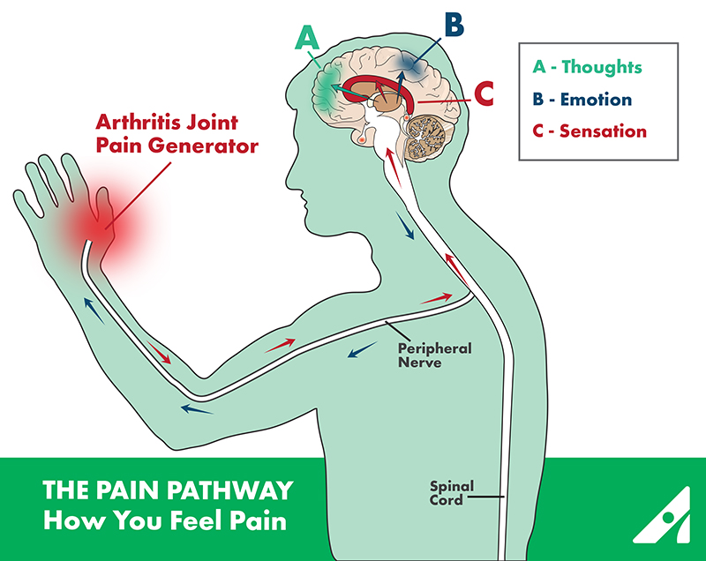

Slide 4
The Basic Pain Pathway

Slide 5
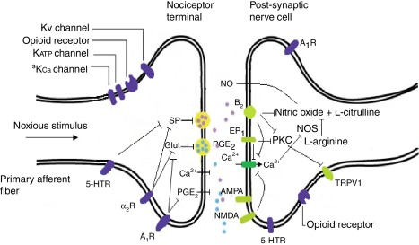

Slide 6
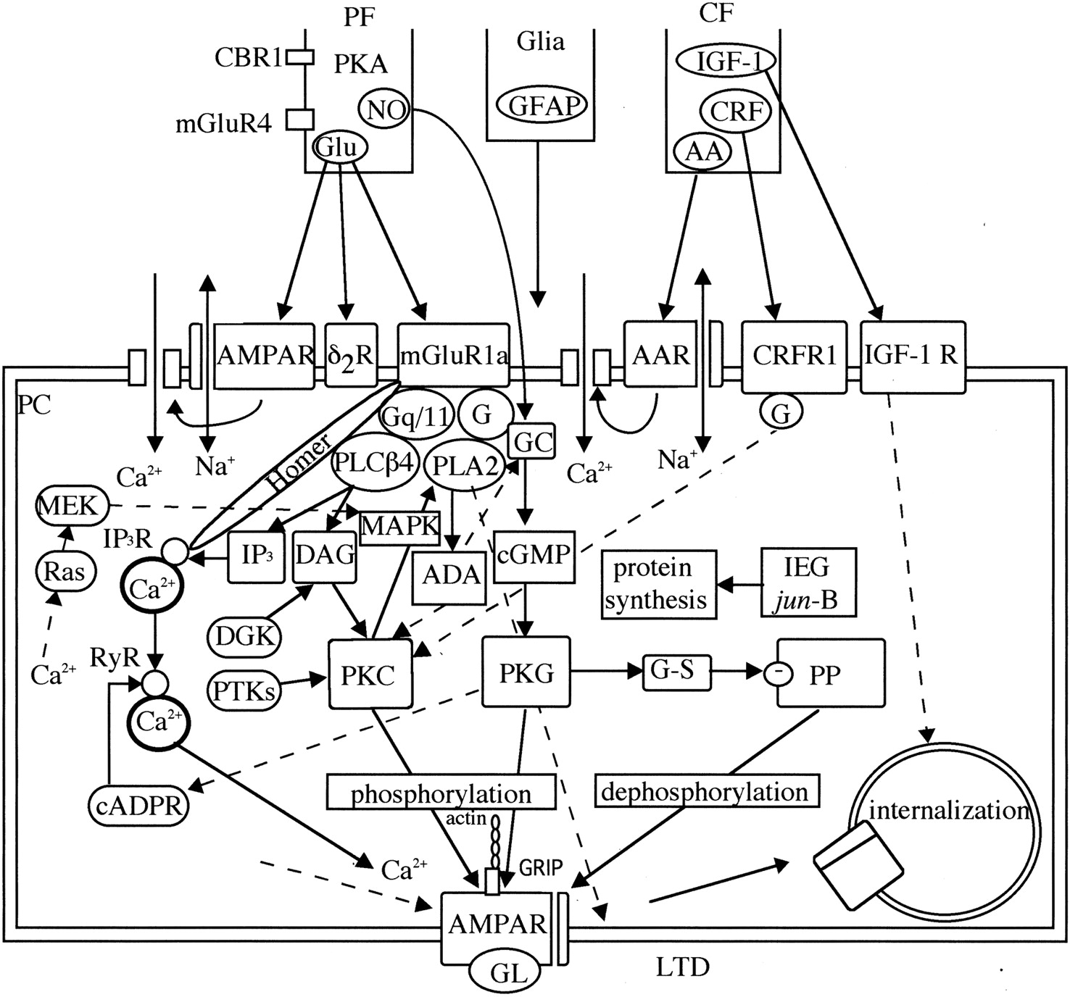

Slide 7
Opioid Prescribing
Chronic pain is highly complex
Opioids alone are often inadequate but helpful
25-50% improvement in pain scales
Opioids are beneficial in small subset of patients
Some patients would do well with discontinuation or reduction of opioids and pursue adjunctive therapies with psychological support
No “universal” efficacy with opioids

Slide 8
Contributing Factors to Inadequate Treatment and Prescribing
Physician lack of knowledge in best clinical practice
Inadequate research
Poor understanding of risk mitigation
Poor utilization of PMP and UDS
Conflicting clinical guidelines
Physician misunderstanding of dependence/addiction
Complete relief may not be an attainable goal

Slide 9
Expectations
Patient and physician usually have a different view
Perhaps the best way to avoid problems
Explain:
Your expectations
Listen to the patients expectations
Come to a middle ground of understanding
Develop a “trust”
Explain the rationale for your decision
Have available a print out of the CDC guidelines

Slide 10
CDC Emphasis: First Line Approach
Non-pharmacological approach
Non-opioid approach
Emphasis on
Behavioral therapies
Functional therapies
Adjunctive medications
Patient and provider expectation
Opioids are a “last resort” option

Slide 11
Are Opioids Efficacious for Chronic Pain?
Long term outcome studies are lacking
CDC insights
Opioid use may be the most important factor impeding recovery of function
Opioids do not consistently and reliably relieve pain and can decrease quality of life
The routine use of opioids cannot be recommended
Appropriate only for selected patients with moderate-severe pain that significantly affects quality of life

Slide 12
Patient Selection and Risk Stratification
History, physical examination and diagnostic testing
Psychosocial risk assessment
Expectations: physician and patient
Risk assessment is an underdeveloped skill for most clinicians
COT should be viewed as a treatment of last resort
Consider all other modalities prior to initiation
Use opioids in addition to a multidisciplinary approach to pain

Slide 13
Chronic Opioid Therapy (COT)
Consensus agreement that it can be useful in carefully selected patients with moderate to severe pain
Demands
Compliance: As with any medical problem
Documentation
Close monitoring through follow up
Vigilant monitoring for abuse and diversion
Assessment of opioid related side effects
Understanding of opioid use in chronic pain

Slide 14
CDC: Initiation of COT
Informed consent and discussion of risk vs. benefit
Therapeutic trial of 4-6 weeks
Exhaustion of other modalities
Insufficient data on starting dose
“ Start low go slow”
Conversion tables
Ongoing monitoring and assessment of benefit vs. risk, expectations and alternative modalities
Consider a taper or wean even in functional patients

Slide 15
Patients at Risk
Psychosocial issues
History of addiction
Risk of relapse, harm and treatment failure
Adverse Childhood Experience (ACE)
Abuse, neglect, household dysfunction and traumatic stressors
Poor motivation and lack of insight
Opioid Use Disorder
Unrealistic expectations

Slide 16
Difficulties: Why?
Patient selection
Pain syndrome
Expectations
High dose opioid therapy
Opioid Use Disorder
Opioid induced hyperalgesia
Reliance only on opioids
Abuse and diversion

Slide 17
CDC Emphasis:
IR vs. ER/LA opioid therapies
Little mention of abuse deterrent medications
Benzodiazepine use with opioids
Significant increase in deaths and ER visits
Acute pain leading to chronic therapy
Methadone
Offering naloxone to patients at risk
High dose opioids

Slide 18
CDC Emphasis: High Dose Opioids
Providers should prescribe lowest possible dose
Additional precautions at > 50 MED’s
Should avoid > 90 MED’s
Demands documented increase in function and no adverse side effects
Recommend consultation over 90 MED’s
Closer follow-up
Consideration of other risk factors

Slide 19
Some Concerns with MED’s
Sudden dose escalations
Errors with opioid rotations
“Start low, go slow”
Data is retrospective
What about the highly functioning patient on opioids
Does not take into account:
Tolerance
Genetics/pharmacodynamics
Pain syndrome

Slide 20
Recent CDC Comments
Patients deserve safe and effective pain management
Taper and reduce doseage only when harm outweighs risk
The guideline is not meant to be a rule, regulation or law
It is not intended to deny access to pain medication
Not intended to take away from physician discretion and decision making
The ultimate goal of the guideline is to ensure patients who need opioids have access to them

Slide 21
CDC Summary Comments
Recommendations are based on the best available evidence
The scientific evidence is low in quality
Much left to be learned about opioid therapy
Need research leading to safer and more effective care
Strong evidence for many pain therapies is lacking
Does the potential harm outweigh the risks

Slide 22
The Adverse Effects of Uncontrolled Pain
Severe deconditioning
Loss of aerobic capacity
Weight gain
Catecholamine surges
Sleep disturbances
Depression and suicide
Persistent pain is a potent stressor
CDC asks: does the potential harm outweigh the risks

Slide 23
The “Ideal” Patient
Well defined pathology
Good insight and desire to improve
Willing to “work hard” to improve
Interested in other modalities and work-up
Not focused on opioids but desire to improve
Good understanding that opioids will provide “some” relief to help them improve
Examples

Slide 24
The “Wrong” Patient
Diffuse and poorly localized pain
No interest in work-up or other modalities
Focus is on opioids alone
Poor insight and unrealistic expectations
Poorly motivated with no desire to “work hard”
Poor functionality
Examples

Slide 25
Drug Seeking?
Even a skilled physician can be “duped”
Common scenarios patient request for opioids or opioid increase
Progression of disease
New painful diagnosis
Psychological issues
Poor understanding of pain and opioids
Failure to use adjunctives or other therapies
Addiction, abuse or diversion

Slide 26
Physician Protect Thyself
Pay attention to a pattern of activity that suggests abuse and address
Monitor closely through follow up and documentation
Use available tools:
PMP database
UDS and pill counts
Opioid risk tools
Obligated to protect yourself, your patient and society from opioid abuse and diversion

Slide 27
Prescription Monitoring Program
Powerful tool
Mandated in Oklahoma first visit and every 180 days
Physician and staff friendly
Helps with determining MED’s
Helpful to determine other scheduled drugs like benzodiazepines
Good “teaching moment” with the patient
Unfortunately a high percentage of overdoses are from non-prescribed opioids

Slide 29
Urine Drug Screening
All new patients and then random unless triggers seen
Becoming standard of care
An excellent education tool for the physician
Insurance driven limitations
Triggers for UDS
Need for confirmatory testing
Is the prescribed drug in the system
Are there illicit drugs or non-prescribed opioids in the urine

Slide 30
Pill Counts
Appropriate disposal of unused meds
Where is the medication if not in the urine?
On-site or at a local pharmacy
Ideally within 24 hours
When switching opioids
In circumstances of signs of diversion
Lockbox or safe

Slide 31
Common Mistakes
Continued escalation of opioids despite no evidence of improvement
Opioids used in pain syndromes know to be poorly responsive
Failure to document
Not addressing psychosocial issues
Lenient with abuse behaviors
Failure to use monitoring systems

Slide 32
Conclusion: Key Points
Thoroughly evaluate the pain complaint
Consider psychological issues
Consider opioids as a treatment of last resort
Use a contract and informed consent
Patients should demonstrate a high level of responsibility
An accountability system must be in place

Slide 33
Oklahoma Dentists and OU College of Dentistry Opioid Crisis Strategies
M EDMUND Braly DDS ACD FAACS
Assoc. Prof, OUCOD Oral/Maxillofacial surgery
Imm. Past President Ok Dent Assoc.

Slide 34
Three hats: Practicing Oral Surgeon, ODA spokesperson, OUCOD professor
Woodward High School Boomer
Alva, Northwestern State Ranger
University Oklahoma College of Dentistry, graduate member first class
University of Oklahoma College of Medicine: four year residency in Oral and Maxillofacial Surgery
Private practice 20 yrs, Enid; private practice 15 yrs, Norman.
Teaching part time 30 yrs; full time 2 yrs
Director of student and resident OMS Clinic, OUCOD
Director of Pre-doctoral OMS Studies, OUCOD

Slide 35
Professional resume, ab.
Board Certified: American Board of Oral and Maxillofacial Surgery
Board Certified: National Board of Dental Anesthesiology
Masters Certificate: American College of Oral/Maxillofacial Surg’s
Fellow, American Academy of Cosmetic Surgery, American College of Dentists, Pierre Fauchard (International Honor) Society, OKU (Academic) Honor Society
Chief of Staff/ Chairman of Board, Integris Bass Baptist Hospital
Physician Surveyor, Accreditation Association for Ambulatory Health Care
Co-Chair, Anesthesia Advisory Committee, Ok Board of Dentistry

Slide 36
Private Practice Oral Surgeon
Write scripts for opioids only three ways vii, xii, or xvii. Basically two day, three day, or four day supply. Caught 2 bad guys!
Never wrote for more than 7.5 mg/tab
International Conference of National Societies of Dental Anesthesiology, world wide perspective on our Rx writing.
Active constant review of other State’s regulations as a consultant and examiner for AAAHC national accrediting agency.
Helped write/edit the latest revisions to the Oklahoma Dental Practice Act. First major revision since 1950’s.

Slide 37
Oklahoma Dental Association- Imm Past Pres
Oklahoma Dental Association has been proactively working with the Oklahoma Board of Dentists to be a positive force in meeting the challenges the State faces concerning opioid use, diversion, abuse, and addiction. Methods: publications and CE
Multiple lectures provided over the last four years at State meetings (last year, 6 hrs), national AAOMS (8 hrs) course, and American Dental Association (multiple courses).
Article written for ODA newsletter on Opioid prescribing and the Oklahoma Prescription Monitoring Program. (Article, unknown to the author until preparing these remarks, is required reading for dental students in their pharmacology course).

Slide 38
American Dental Association Oklahoma Dental Association American Association of Oral and Maxillofacial Surgeons
All Dental organizations are now involved in pro-active provider continuing education on the opioid crisis
ODA Patrick Sammon, PhD. Univ Kentucky CODent, COMed, physiologist. Tulsa, ODA meeting this year. Six hours of CE “The new face of drug abuse”- 3hr and “Prescription Drug Abuse, Addictive Disorders, and Prescription Monitoring Programs”- 3hrs. SW Dental Meet, Dallas the year before. Instructor, Fed Law Enforcement and Counter Drug Task Force Training Programs.
AAOMS Keynote Speaker this year: Andrew Kolodny MD, Psychiatrist. Director, Opioid Policy Research, Heller School for Social Policy and Managment, Brandeis University. “Opioid and Heroin Crisis: An Epidemic of Addiction”. This month free to all 7,500+ OMS in US. Permission to use in OUCOD classes, recorded speech, handouts. (His handout of keynote speech included in this Commission's record.)

Slide 39
Teacher, OUCOD
We teach that opioids are only to be used when other less addicting medication will suffice. Typically, we teach four third molar removal requires Ibuprofen, 600 q6hrs.
Two jaw surgeries get 4 day Rx for opioids, not renewed.
Follow up Rx’s Ibuprofen, or suggest OTC.
Pharmacology in Dental School, team taught by the Pharmacology Department, OUHSC. 14 week semester equivalent.
Two hours on medications specific to sedation and anxiety in dental office

Slide 40
Pharmacology course
Semester equivalent, one hour/week plus individual reading and an pharmacy observation requirement.
Includes not only pharmacology lectures, but also:
Drug Laws, including penalties
Prescription Monitoring Program
23 page Office Based Opioid prescribing guidelines (OSMA, OK
Board of Dentistry, D.O. Board, Pharmacy Board, Ok Dept Health, et. al.)
Includes Pt. Handouts and Poster downloads.
Additional pharmacology in the Control of Pain and Anxiety course: 14 weeks course (2 hours lecture/week), 10 of 14 weeks on pharmacology of local anesthetic drugs, antibiotics, sedation medication, PMP, and Rx writing.

Slide 41
What we teach:
Opioids should not be used unless other less addictive medications will not suffice for ACUTE PAIN.
Opioids should be written for no more than a FOUR DAY SUPPLY, and should a follow on Rx be required, one should try NSAIDS or have patient move to OTC meds.
Rx’s are not renewed without patient returning for follow-up examination.
Appropriate queries to OK PMP Aware website must be documented in the patient record. (180 days)
First lecture on Drug Laws and Prescription Writing
Keep opioid naïve patients naïve! Especially teens.

Slide 42
Teaching Drug Laws and Prescription Writing.
Description of the scope of practice of Dentists related to prescribing medications and the grounds for penalties.
State Pharmacy Act: “licensed practitioners”…”includes Dentists licensed to practice and authorized to prescribe dangerous drugs within the scope of practice of such practitioner” No DDS BCP’s!
Pharmacists responsibility…to use professional judgement…is this a legitimate medical purpose by an authorized prescriber acting in the usual course of the practitioner’s professional practice?
Proper prescriber/patient relationship? Pt ID, diagnosis, discussion of treatment plan and options, offer counseling, provide follow up care.
NO 1st degree relationships (spouse, children, or parent) and NO 2nd degree relationships (sibs, grandparent, grandchild)

Slide 43
Teaching PMP, what we’ve learned.
Many patients will not volunteer that they have other prescribers
New York experience is taught in “Avoiding Pain and Anxiety” class. Literature showing a nearly 70% reduction in the number of opioids prescriptions, and 78% fewer pills prescribed in that State after it enacted the requirement that prescribers check the PMP websites. “Impact of a Mandatory PMP on Prescription of Opioid Analgesics by Dentists” Rasubala, L. et al, PLoS, Aug 2015.
Half of opioid Rx’s are not taken completely- ADA, Dec 2016
Univ. Penn 6months, 4/3rds, 94% got opioid Rxs, 79pts, 5 took all, the rest had over 1,000 unused opioid pills in their homes. Day 1 pain 5, day 3 pain 0-3 50%, day 5 pain 0-3 80%. Journal of Drug and Alcohol Dependence. Extrapolation to USA/yr, over 100 million unused opioid pills. Average pt took 13 pills total.

Slide 44
Teaching what we’ve learned….cont.
Additional required reading in Controlling Pain and Anxiety course:
Letter and accompanying information from Ok Department of Health on Oklahoma Prescribing Guidelines:
Opioid Treatment for Acute Pain… 1-9. no long acting, timed released forms, usually three days or less, not with benzodiazepines (greatly increases chance of addiction), no replacement for “lost” Rx’s, check PMP, provide intervention and referral if indicated. Provide patient education risks/disposal.
Opioid Treatment for Chronic Pain… we teach this is NOT INDICATED IN DENTISTRY; patient should be referred to an Interventional Pain Physician for “chronic pain,” even if of a Dental etiology.

Slide 45
What we’re teaching our students (OUCOD) and recommending to colleagues (ODA, AAOMS) cont.
Limit opioid prescription to 3 days if possible, 4 days at most. Literature clear this is all that’s needed, and very little chance of addiction in that short period of time.
Don’t prescribe opioids for chronic pain, refer those patients for counselling and pain management. Not with benzodiazepines.
Don’t prescribe opioids if other non-opioid pain medications will suffice, i.e., NSAIDS, etc.
Advise patients of risks of opioid abuse/diversion/addiction
Only prescribe to those with whom you have an appropriate doctor-patient relationship
Advise patient on the importance of proper disposal of unused pills.

Slide 46
Issues Remain
We know that ½ of the prescriptions written are never filled. Pain medications usually are, antibiotics less so.
We know that patients usually only use approximately ½ of any pain prescription for the use it was written.
We know that many of these partially used pain prescriptions remain in patients’ bathroom drawers and medicine cabinets (“in case they need it for something else”) 100 Million pills in US per year from Dentists alone?
We call “using it for something else” diversion or abuse. We teach that. Yet, when asked, students will raise their hands and admit that they have unused meds in their homes. Old habits die hard.
We teach proper disposal of medications, but some states are schizophrenic.. Some say flush (Oklahoma), others say that hurts the environment… We need a more formal system, with rewards (?).

Slide 47
More Issues.
Epidemic started in 1996
Marketing for Rx Opioids has skyrocketed since (See attached handout from keynote speech)
Growth curve in marketing is closely followed by curve of Rx’s, which is followed closely by curve of deaths by overdose
Fentanyl deaths first counted in 2016, climbed 540% in three years.
In one year, more Americans killed by drug overdose than in the entire Viet Nam war. That wall gets bigger each year.
Oklahoma: 1999 15-18 deaths per 100,000 population over 12
Oklahoma 2009 45 ++ deaths per 100,000 population over 12

Slide 48
Patients tweet, re-tweet, twitter,demand,and Yelp
Yelp, BBB, Consumer Affairs, Expresit, Foursquare, Glassdoor, Google Reviews, Home Advisor, Judy’s Book, Manta, Merchant Circle, Open Table, Planet Rate, Vend OP, Angie’s List…..ad infinitum
These aren’t even many many out their for rating our feelings about our doctors and our dentists.
Live by social media/ die by social media The Millinial Factor
Insurance companies and even CMS several years back pushed the concept of “Pay for Performance”…it included patient satisfaction, and that put a wedge between not only the doctor and the patient, but also between the doctor and medical ethics.
Do I do write what’s right and get yelped, or cave when I shouldn’t? This is a major discussion among Dental Ethicists now….. ACD surveying ODA dentists on this issue this month (anonymous).

Slide 49
Strategies for successfully curbing the epidemic
Take “patient satisfaction” out of the review of “performance”. Outcomes can be measured clinically (return to surgery, re-admission, multiple procedures on the same tooth, etc.,) but get yelp out of that metric . The rest, market forces should correct.
Public education on appropriate pain medication use and formal disposal system. We keep pointing the finger at somebody else (doctors, loose borders, fake pharmacies, youth culture, Big Pharma, etc.) We know it’s inappropriate to stay too long in the left lane….do we know it’s inappropriate to doctor shop?..to hoard old prescriptions?
We keep track of prescribers’ activities…why not track and counsel doctor shoppers?
Is having unused opioids in the family bathroom child endangerment? Marijuana= yes, opioids via 2 yr/old Rx= no? Nothing happens…. until something happens.

Slide 50
How big is the problem?
Prescribers have been aware for years, since 1996-97.
Norman M.D. offices (three that I’ve visited) “We do not write pain prescriptions on Fridays. If you are worried that you do not have enough pain medicine to make it through the weekend you must come in and discuss it with us on Thursday”
Seems silly…..but we’ve seen the doctor shopper epidemic for years before it became the opioid addiction/diversion/abuse epidemic that it is today. Fake root canals, etc. “My dentist is out of town for the weekend, but he said you were a good dentist”……… Still, Wednesday’s surgery patient does not want to hear he can’t get pain meds from his doctor on Friday…he will “Yelp.” Friday saw a patient threaten physical violence to doctor and assistant. Takes patient satisfaction to a whole new universe…

Slide 51
Oklahoma Dental Education is doing its part..but there are factors….
Many of our students do not stay and practice in Oklahoma, 50%
Many of our State’s new dentists trained in another State
Not all States require PMP checks
Nothing happens until something happens (like pilot logbooks)
Top ten Dental prescribers of dangerous drugs are reported each month to the Board of Dentistry. (As are each provider type, to their respective Boards)
PMP violations carry only those penalties prescribed by the Board of Dentistry. Nothing happens until something happens…

Slide 52
Thank You for your time. Questions?
M. Edmund Braly DDS FACD FAACS
edmund-braly@OUHSC.edu

Slide 53
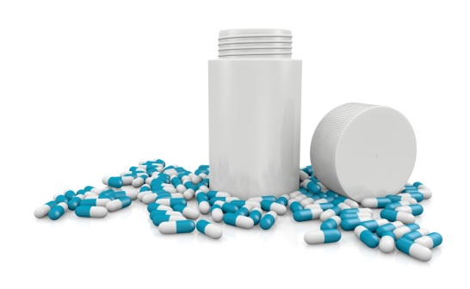
Oklahoma Medicaid Responds to the Opioid Crisis
Mike Herndon, D.O. Chief Medical Officer
Burl Beasley, D.Ph. , MPH, MS. Assistant Pharmacy Director

Slide 54
Agenda
Introduction/Background
OHCA Initiatives
Pharmacy Initiatives
Naloxone
Patient Review & Restriction-Lock In
Results
Summary

Slide 55
Poisoning-Drug Overdose Death Rates - Oklahoma 2014 Source: OSDH, Injury Prevention Service, Unintentional Poisonings Data

Slide 56
SoonerCare/Medicaid Cause of Death Drug Poisoning Mortality - CY2014

Slide 57
OHCA Initiatives

Slide 58
OHCA Initiatives
Pain Management Program & Toolkit
State Plan & Workgroup Involvement
Collaboration within and with other state agencies
Lock-in Criteria Enhancement

Slide 59
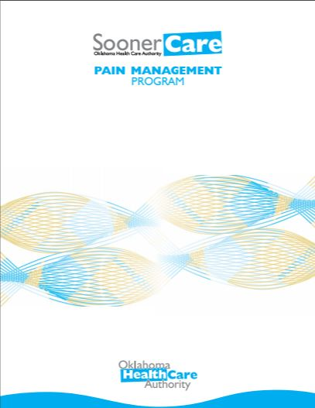
SoonerCare Pain Management Program
The SoonerCare Pain Management Program is a designed to equip SoonerCare providers with the knowledge and skills to appropriately treat members with chronic pain. To accomplish this, the Oklahoma Health Care Authority (OHCA) developed a proper prescribing toolkit.

Slide 60
SoonerCare Pain Management Program
Three registered nurse (RN) practice facilitators are delegated to implement the components of the toolkit within selected SoonerCare practices.
Additionally, two licensed alcohol and drug counselors are dedicated to assist providers with linking members with substance use disorder, or other behavioral health needs, to the appropriate treatment.

Slide 61
Toolkit Contents
Treatment protocols
Prescribing guidelines
Office visit forms
Patient handouts
Monitoring recommendations
Other resources

Slide 62
Navigation to Pain Management
Toolkit
Log on to www.okhca.org/painmanagement
Click on “Pain Management Toolkit”

Slide 63
Pharmacy Initiatives Scope and Utilization
Tiered structure for receiving long-acting opioid
Duplication edits for short-acting and long-acting opioids
DUR - concomitant use of opioid and benzodiazepines
Methadone restrictions – January 2017

Slide 64
Pharmacy Initiatives Scope and Utilization (cont.)
Quantity limits
No more than 4 per day
Jan 2015
Early refill limit
90 % of the medication must be used before refill
Cumulative early refill limits
Notes:
Methadone accounts for a disproportionate share of opioid overdoses. (OHCA at 13% vs 30% national data) Moved Tier 3 with PA requirements effective January 5, 2017.
Opioid review DUR July.

Slide 65
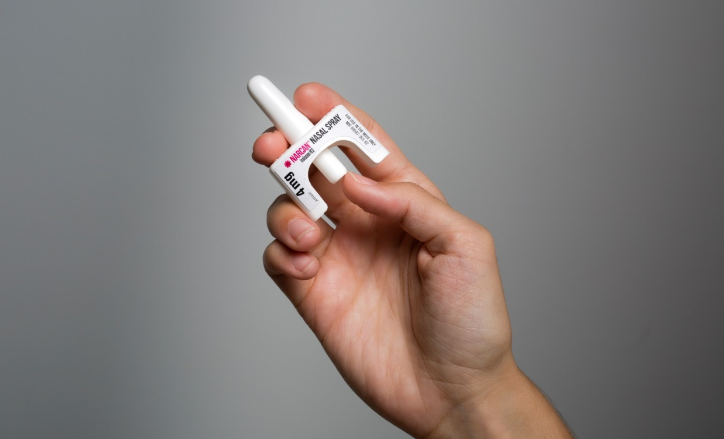
Naloxone

Slide 66
Naloxone
OEND program with ODMHSAS
416 kits >20 y.o.
218 kits distributed 19 y.o. via CHIP program
1 save of 17 y.o.
634 Total kits October 2015- July 2016
OHCA
Increase in naloxone claims paid
#0 – 2013
#459 - 2017
Notes:
Over 1000 kits in Oklahoma since inception of program

Slide 67
OHCA Naloxone Claims CY 2013 – CY 2017
Source: OHCA Pharmacy Services. Data valid as of November 1, 2017.
Notes:
CY 2016 has seen the largest amount of naloxone claims to date as of June 30th 224 claims for naloxone. Due to increase in Narcan Nasal Spray.
Does not include long-acting injectable, and excluded the Evzio as well – 2 claims.
OKDOH – 15 months – 53 Admins, with 42 lives saved.
As of 5/13/2016 #87 Naloxone claims. #10/87 are the Narcan Nasal Spray (March & April)

Slide 68
Naloxone Next Steps
No co-pay on Rx naloxone
Will NOT apply to Rx limit
December 1, 2017
Expand education and collaboration

Slide 69
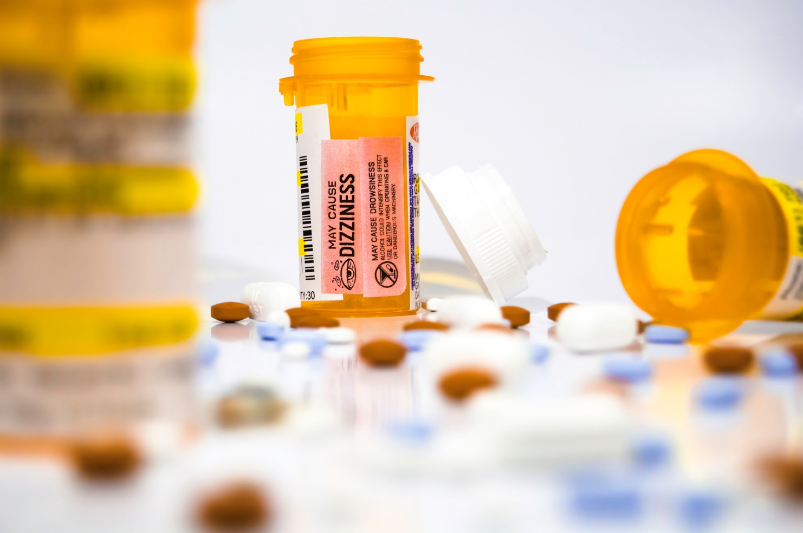
Patient review and restriction program Lock-in

Slide 70
Lock-In Program
SoonerCare Pharmacy-administered program
“Locks” a member into one pharmacy AND one prescriber
Pharmacy claims will deny if not from designated providers
Various medications monitored
Referral by health care providers
Notes:
CDS lock in only, other meds are available from other providers/pharmacies.
Cash pay an issue. Anonymous
FAX/Call SoonerCare Pharmacy Helpdesk

Slide 71
Communication Strategies

Slide 72
Neonatal Abstinence Syndrome in Oklahoma
Mary Anne McCaffree, MD
Neonatal Perinatal Medicine
University of Oklahoma
Joyce Marshall, MPH
Maternal & Child Health Service
Oklahoma State Department of Health
December 19, 2017

Slide 73
What is Neonatal Abstinence Syndrome (NAS)?
A group of problems that occur in a newborn who was exposed to addictive opiate drugs while in the mother’s womb
A withdrawal syndrome experienced after birth by drug exposed newborns
Generally follows opioid exposure, though other drugs implicated
Alcohol, benzodiazepines (valium, etc.), barbiturates (phenobarbital, etc.), and certain antidepressants (SSRIs)
Source: MedlinePlus Medical Encyclopedia and March of Dimes

Slide 74
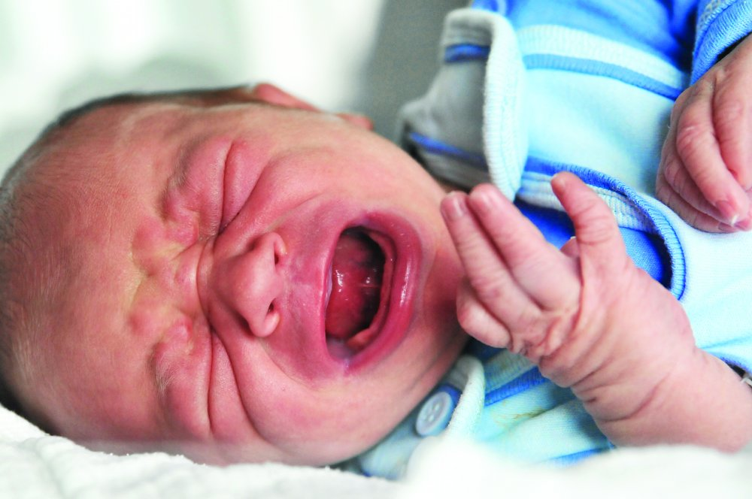

Slide 75
NAS Video 1
video

Slide 76
Do More Opioids Equal More NAS?

Slide 77
Opioids
Prescriptions increased 4-fold over last ten years
More deaths than car accidents
In 2012, enough were prescribed to give every adult in the USA one prescription
Rising deaths from heroin and synthetic opioids
Source: Centers for Disease Control and Prevention

Slide 78
Opioid Prescription Rates by State (per 100 persons)
Source: CDC, National Center for Injury Prevention and Control,
Division of Unintentional Injury Prevention, 2016

Slide 79
Unintentional Opioid-related Overdose Death Rates¹ and Opioid Sales per Person², Oklahoma, 2000-2016
Notes:
¹ Oklahoma State Department of Health, Injury Prevention Service, Fatal Unintentional Poisoning Surveillance System (Abstracted from Medical Examiner reports)
² U.S. Department of Justice, Drug Enforcement Administration, Office of Diversion Control, Automation of Reports and Consolidated Orders System (ARCOS) Reports, Retail Drug Summary Reports by State, Cumulative Distribution Reports (Report 4).
Opioid sales per person for 2000-2006 were calculated by CDC EIS officer Emily Piercefield for a previous publication using the methodology below.
Morphine milligram equivalents for major opioids (oxycodone, hydromorphone, hydrocodone, meperidine, methadone, morphine, fentanyl, codeine) calculated using Paulozzi and Budnitz, Pharmacoepidemiology and Drug Safety, 2006

Slide 80
Opioid Use During Pregnancy

Slide 81
Percentage of Women With an Opioid Pain Reliever in the 2nd or 3rd Trimester
Epstein RA, Bobo WV, Martin PR, et al. Increasing pregnancy-related use of prescribed opioid analgesics. Ann Epidemiol. Aug 2013;23(8):498-503.

Slide 82
Births = 30,510
Oklahoma State Medicaid Claims Data
State Fiscal Year (SFY) 2016
3,946 members with opioid prescriptions filled (up to three days before delivery)
Per trimester
1st trimester = 1,495 members/2,381 claims
2nd trimester = 1,863 members/3,056 claims
3rd trimester = 1,844 members/3,224 claims
*Member count is duplicated due to members in multiple trimesters.

Slide 83
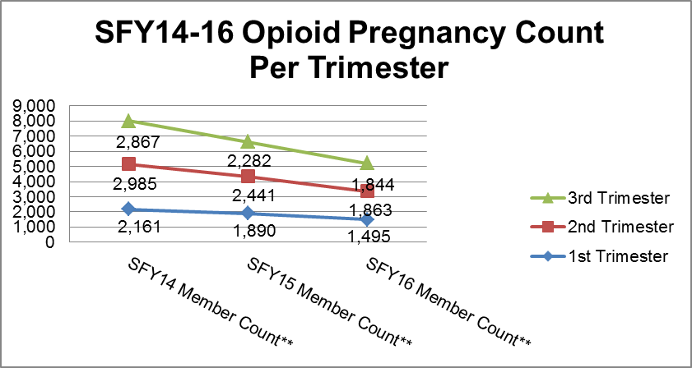
OHCA opioid pregnancy decline

Slide 84
National Collaborative on Maternal Opioid Use Disorder
Identify current resources, identify gaps, and identify strategies to scale local programs into state and national programs.
Identify measures of success that are:
Nationally available
Available through low burden means

Slide 85
National Collaborative on Maternal Opioid Use Disorder Participating States
Illinois
Maryland
Massachusetts
New Jersey
New Mexico
New York
Northern New England
Ohio
Oklahoma
Tennessee
Texas
Virginia

Slide 86
Neonatal Abstinence Syndrome

Slide 88
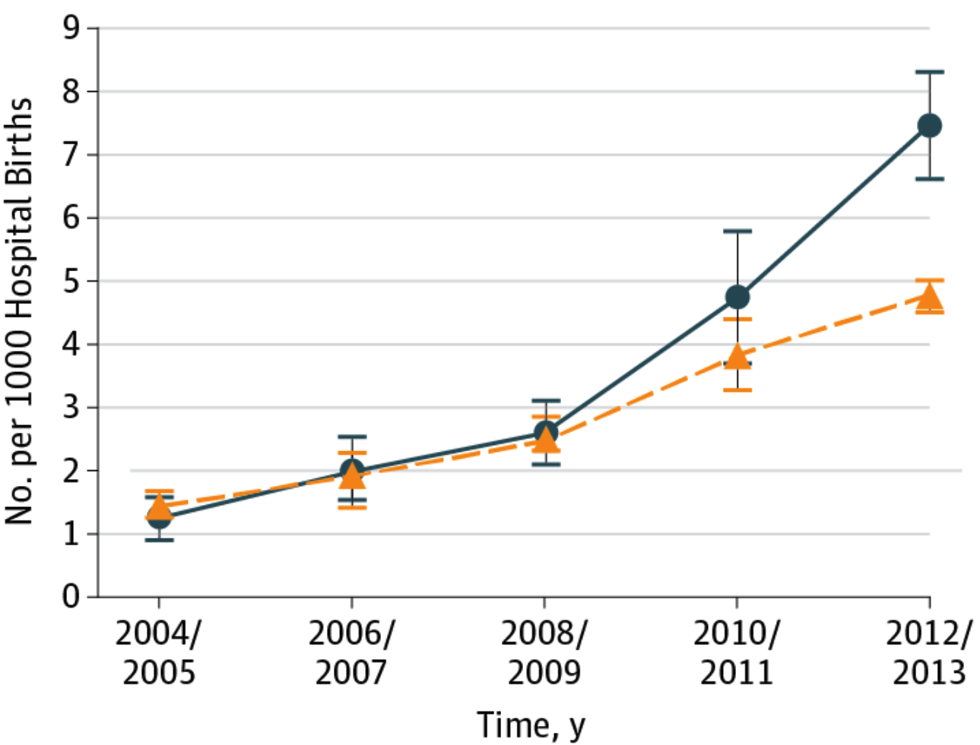
Neonatal Abstinence Syndrome in Rural vs. Urban Communities
Villapiano NLC, Winkelman TNA, Kozhimannil KB, Davis MM, Patrick SW. Rural - Urban Differences in Neonatal Abstinence Syndrome and Maternal Opioid Use, 2004-2013. JAMA Pediatrics. 2016 Dec 12.

Slide 89
Number of Neonatal Abstinence Syndrome Hospitalizations
Source: Oklahoma Hospital Inpatient Discharge Data, 2012-2016

Slide 90
Number and Rate of Medicaid Births with Neonatal Abstinence Syndrome
Source: Oklahoma Health Care Authority, 2008-2015

Slide 91
Mean LOS and Hospital Charges for NAS, 2009-2012
 | 2009 | 2010 | 2011 | 2012
Mean LOS (day) | 22.7 | 22.9 | 22.8 | 23.0
Mean Charges* (2012 US$) | $75,700 | $80,500 | $87,700 | $93,400
*p<0.001
Patrick SW, Davis MM, Lehmann CU, Cooper WO. Increasing incidence and geographic distribution of neonatal abstinence syndrome: United States 2009 to 2012. J Perinatol. 2015;35(8):650-655.
Notes:
Mean inflation adjusted hospital charges for NAS increased steadily over the last decade

Slide 92
Total Hospital Charges for NAS, 2009-2012
 | 2009 | 2010 | 2011 | 2012
Medicaid* | $560M | $870M | $900M | $1.2B
Private Payer* | $130M | $170M | $210M | $200M
Self Pay* | $20M | $40M | $30M | $40M
Other Payer* | $14M | $30M | $30M | $30M
Total Charges* | $730M | $1.1B | $1.2B | $1.5B
*p<0.001
Patrick SW, Davis MM, Lehmann CU, Cooper WO. Increasing incidence and geographic distribution of neonatal abstinence syndrome: United States 2009 to 2012. J Perinatol. 2015;35(8):650-655.
Notes:
And overall, the total US hospital bill grew from $190 to 720 million dollars

Slide 93
Oklahoma Perinatal Quality Improvement Collaborative (OPQIC) Opioid Use Disorder in Pregnancy and Neonatal Abstinence Syndrome Work Group
Neonatology
Obstetrics
Maternal Fetal Medicine
OB Nursing
Neonatal Nursing
Social Work
Mental Health
Public Health

Slide 94
Key Intervention Points
Preconception
Promote awareness of prenatal substance use
Universal screening, brief intervention and referral to treatment
Pregnancy
Universally screen pregnant women for substance abuse and make referrals to treatment when appropriate
Provide enhanced prenatal services
Birth
Use consistent and effective protocols for identification of substance-exposed newborns
Make referrals for developmental or child welfare services as needed
Infancy
Life Span
Provide developmental services
Ensure an environment safe from abuse and neglect
Respond to immediate needs of family members
Identify and responds to needs of exposed child
Respond to needs of mother and family members
Provide appropriate education, screening and support as children move through life span
Source: O’Brien ML, Phillips SM. “Substance exposed newborns: Addressing social costs across the lifespan.” The Massachusetts Health Policy Forum.
No. 40. 2011. Available at http://masshealthpolicyforum.brandeis.edu/forums/Documents/FINAL-SEN-IssueBrief_For-Print.pdf. Accessed 7-31-2013.

Slide 95
NAS Video 2
video

Slide 96
Clinical Features of NAS
Gastrointestinal
Poor feeding/vomiting/loose stools
Leading to dehydration and poor weight gain
Central nervous system
Tremors/hypertonia
Irritability/decreased sleep
Exaggerated reflexes
Seizures
Autonomic activation
Tachypnea
Yawning
Dilated pupils

Slide 97
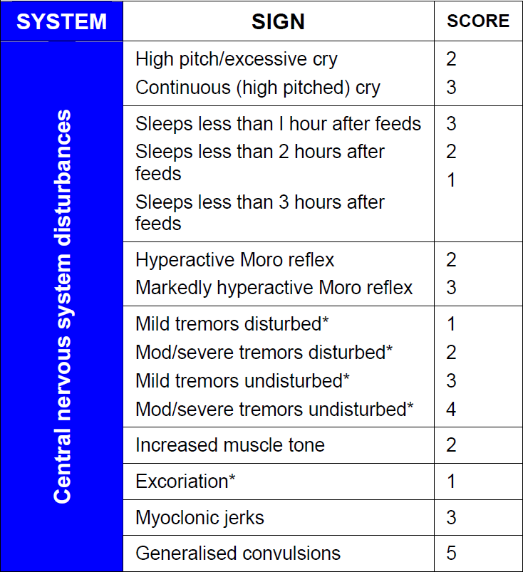
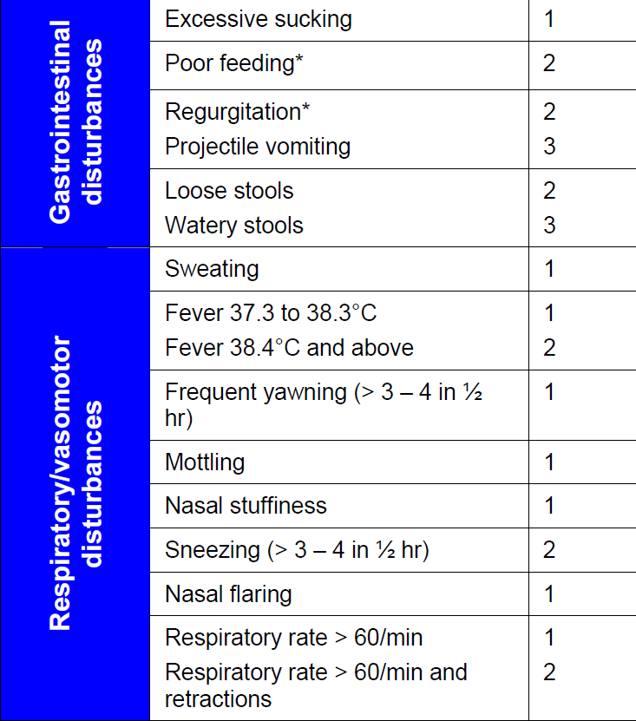
Zimmermann-Baer U. Finnegan neonatal abstinence scoring system: normal values for first 3 days and weeks 5-6 in non-addicted infants. Addiction (Abingdon, England). 2010;105(3):524-528.

Slide 98
Emerging Issues and Strategies

Slide 99
Opioid Agonist Therapies (OAT)
Methadone and Buprenorphine (both recommended)
Approved to treat opioid use disorder in pregnancy
Mother: Less risk of overdose death and relapse
Infant: More likely to go to term, higher birthweight, and experience less distress
NAS risk

Slide 100
Pregnant Women in Treatment Getting OAT
Analysis of the Substance Abuse and Mental Health Administration’s Treatment Episode Discharge Dataset. Sample: Pregnant women treated for opioid use disorder in FL, KY, MA, MI, MO, NY, NC, TN, WA, WV; 2013.

Slide 101
Hospital Variability and Standardized Care
There remain significant inter and intra-hospital variation in treatment and outcomes for NAS
Recent study of US children’s hospitals:
Only 5/14 used the same pharmacotherapy >80% of the time
Two-fold differences in risk-adjusted length of stay
Large international quality improvement collaborative of 199 hospitals
44.8% had a policy to standardize scoring
48.6% had a policy on breastfeeding a substance-exposed infant
68.0% had a policy on pharmacologic treatment of NAS
Patrick SW, Kaplan HC, Passarella M, Davis MM, Lorch SA. Variation in treatment of neonatal abstinence syndrome in US Children's Hospitals, 2004-2011. J Perinatol. 2014.
Patrick SW, Schumacher RE, Horbar JD, et al. Improving Care for Neonatal Abstinence Syndrome. Pediatrics. 2016;137(5).

Slide 102
Rooming In
Rooming in to create an environment where moms/babies can stay together when possible
Culture differences between NICU, newborn nursery, and general inpatient wards?
Environment in NICU helpful during NAS?
Open bay?
Lighting (e.g. bright?)
Noise level (e.g. loud, overstimulating?)

Slide 103
Breastfeeding
Breastfeeding safe and effective
Promotes bonding
Very little OAT medications in breastmilk
Recent blackbox warning for codeine, tramadol
Reduces LOS for NAS
Clear exclusion – HIV, HCV with cracked/bleeding nipples
Academy of Breastfeeding Medicine
Appropriate: >90 days in treatment
Inappropriate: Active illicit use
Maybe: >30 days in treatment
Source: Stephen W. Patrick, MD, MPH, MS, Vanderbilt University Medical Center

Slide 104
Recommendations
Standardized protocols for treatment
Collaborative, multidisciplinary, nonjudgmental care based on needs of infant-mother dyad
Pharmacologic treatment as indicated
Rooming in and breastfeeding support unless medically indicated otherwise
Gentle, soothing environment with minimal stimulation to calm and soothe infant
Adequate nutrition to minimize weight loss
Medical follow-up care and social services following discharge
Source: Neonatal Abstinence Syndrome
Karen McQueen, R.N., Ph.D., and Jodie Murphy-Oikonen, M.S.W., Ph.D.
N Engl J Med 2016; 375:2468-2479December 22, 2016DOI: 10.1056/NEJMra1600879

Slide 105
Acknowledgements
Oklahoma Healthcare Authority
Stephen W. Patrick, MD, MPH, ,MS, Vanderbilt University Medical Center
Tennessee Department of Public Health
Oklahoma State Department of Health
University of Oklahoma
Oklahoma Perinatal Quality Improvement Collaborative

